Slide 1
The fate of attractors when coupling identical multi-stable systems
Coupled multi-stable synchronisation
Jonas Brown - EPSRC Summer Research Project

Slide 2
Content
What are we investigating?
How are we investigating?
System choice and setup.
Simulation and first observations.

Slide 3
What are we investigating?
When coupling identical dynamical systems:
Weak coupling often results in small changes in the behaviour of the system, and we can usually interpret the coupled system as independent from one another.
Stronger coupling typically leads to synchronised behaviour.
An open problem in coupled dynamical systems is what occurs when the individual systems are multi-stable.
For no coupling strength the individual systems can stabilise in all possible pair-wise combinations of attractors.
However, for non-zero coupling the resulting behaviour is non-trivial.

Slide 4
How are we investigating?
We will couple identical copies of systems and study their behaviour while varying both the coupling strength and the initial configuration of the individual systems.
Our aim is to record and analyse attractors, discerning which survive weak coupling given the coupled system can still be interpreted as two independent systems that stabilise to an attractor that is nearly identical to an attractor of the isolated system.
AIM: We want to identify surviving attractors and whether they have synchronised.
Then compare results from fundamentally different dynamical systems to provide general directions of more focused research.

Slide 5
System choice and setup
We chose to start by coupling two identical tri-stable Fitzhugh-Nagumo systems as it has 3 well-defined attractors: a fixed point and two limit cycles (one small and one large amplitude).
We then used the initial conditions for known attractors in the system to analyse what behaviour they exhibit.

Slide 6
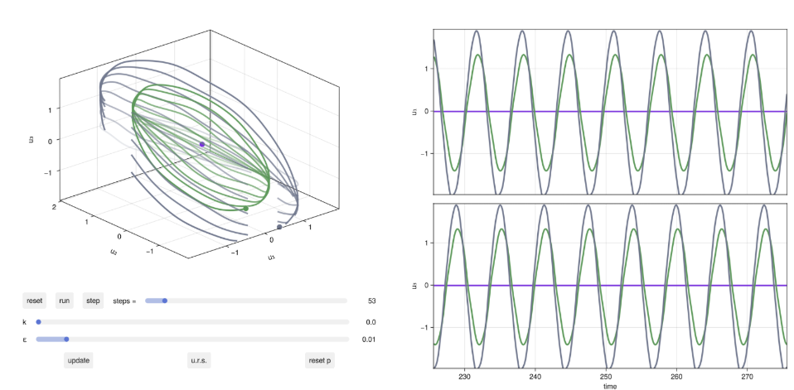
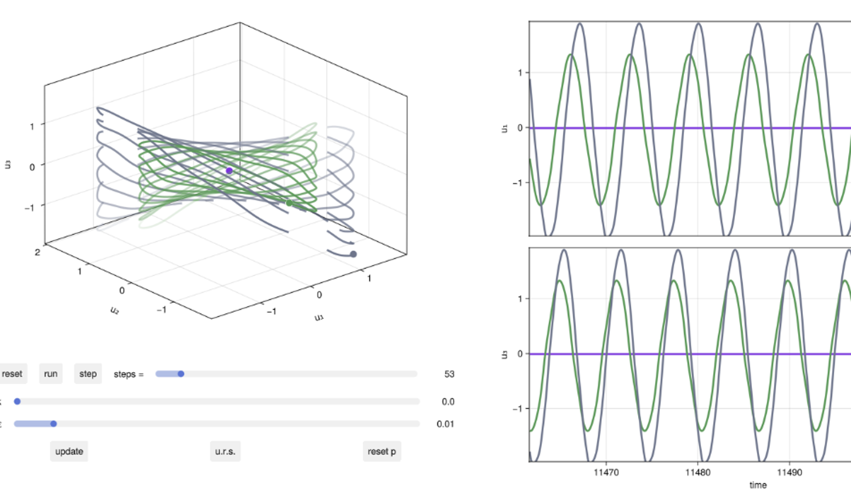

Simulations and first observations
Simulating the coupled systems and varying the coupling strength ($k$ value) provided observable behavioural groups around specific values.
For $0≤k≤0.009$:
Systems behave independently as if they were uncoupled, rotating around a central fixed point.

Slide 7
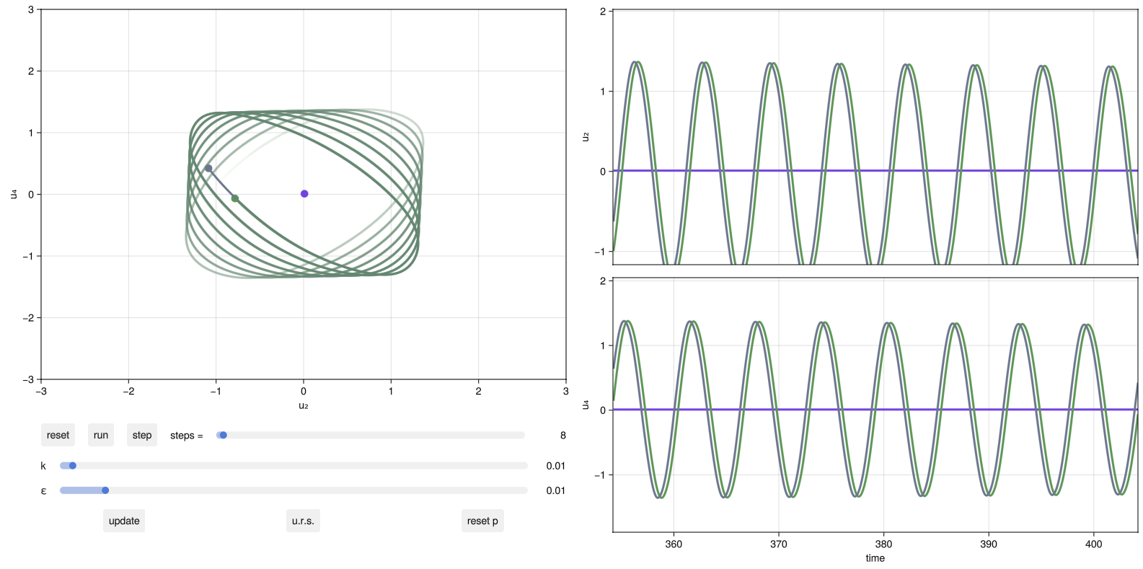

Simulations and first observations
Simulating the coupled systems and varying the coupling strength ($k$ value) provided observable behavioural groups around specific values.
For $0.009<k≤0.016$:
As $k$ increases, the two limit cycles coalesce and eventually form only one limit cycle.

Slide 8
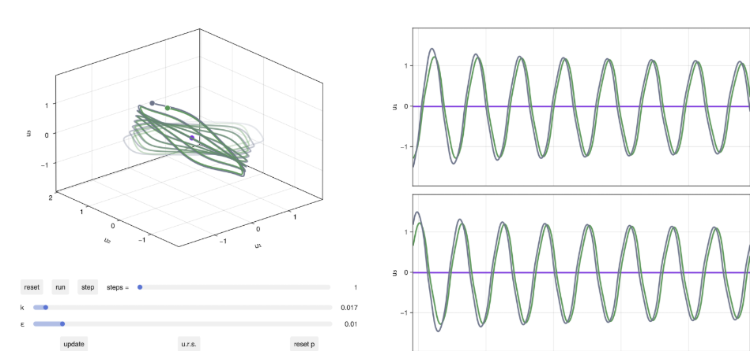
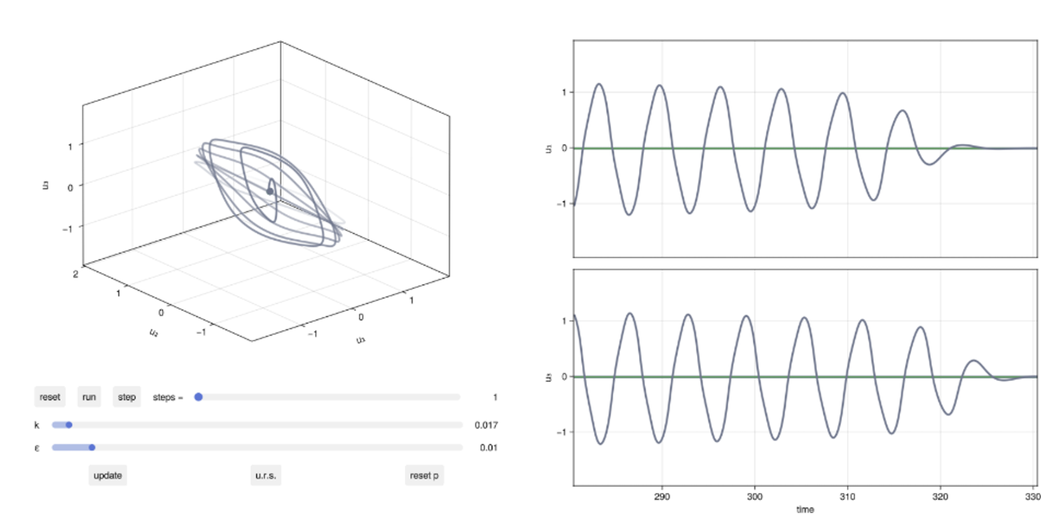

Simulations and first observations
Simulating the coupled systems and varying the coupling strength ($k$ value) provided observable behavioural groups around specific values.
For $0.016<k≤0.04$:
The limit cycles collapse into the central fixed-point attractor.

Slide 9
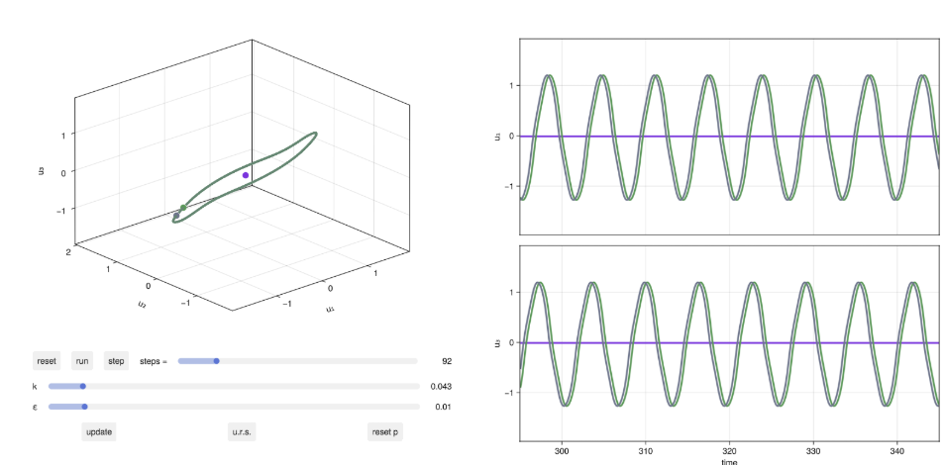

Simulations and first observations
Simulating the coupled systems and varying the coupling strength ($k$ value) provided observable behavioural groups around specific values.
For $0.04<k≤0.057$:
A limit cycle reforms around thee central fixed-point. Very interesting behaviour!

Slide 10
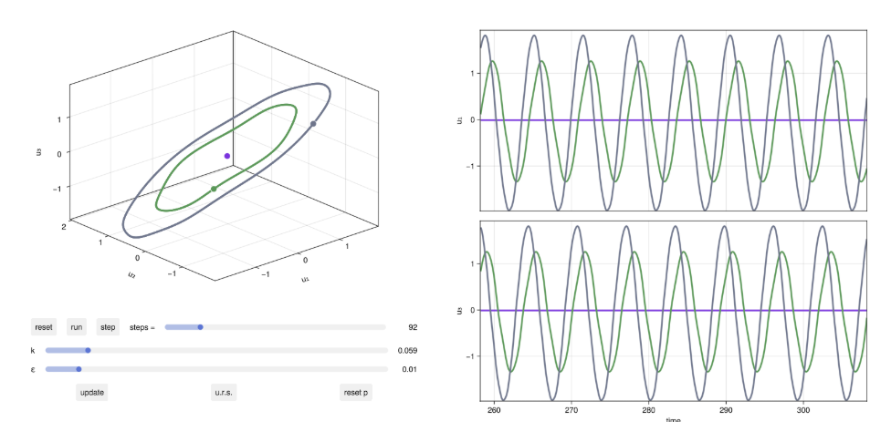

Simulations and first observations
Simulating the coupled systems and varying the coupling strength ($k$ value) provided observable behavioural groups around specific values.
For $k≥0.058$:
The system returns to the original 3 states of the TFN system, as the coupling is now strong enough for the two to act as one system.

Slide 11
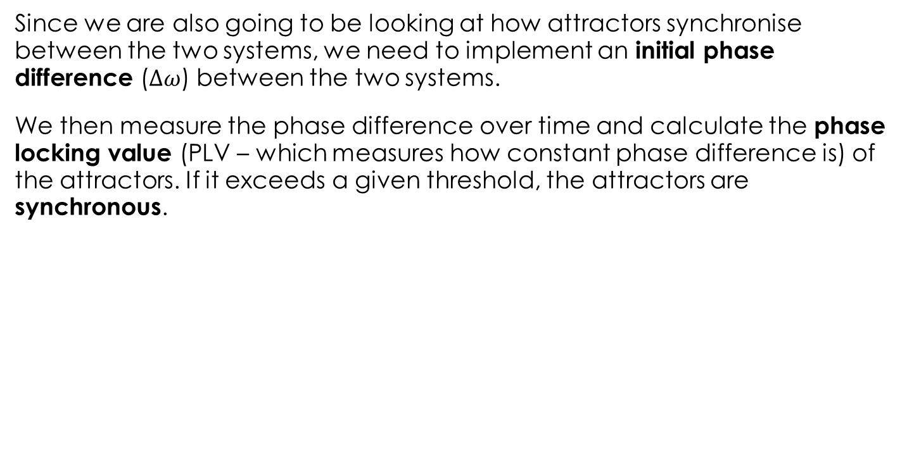
Measuring synchroneity
Since we are also going to be looking at how attractors synchronise between the two systems, we need to implement an initial phase difference ($∆ω$) between the two systems.
We then measure the phase difference over time and calculate the phase locking value (PLV – which measures how constant phase difference is) of the attractors. If it exceeds a given threshold, the attractors are synchronous.

Slide 12
Classification of attractors
Large small limit cycles
Fixed point

Slide 13
All potential attractors
Pairwise matching

Slide 14
Counting synchronous

Slide 15
Plots

